Slide 1



Ricardo Gutierrez
Mentor: Dr. Thomas Sharp
DATA RESULTS

Slide 2
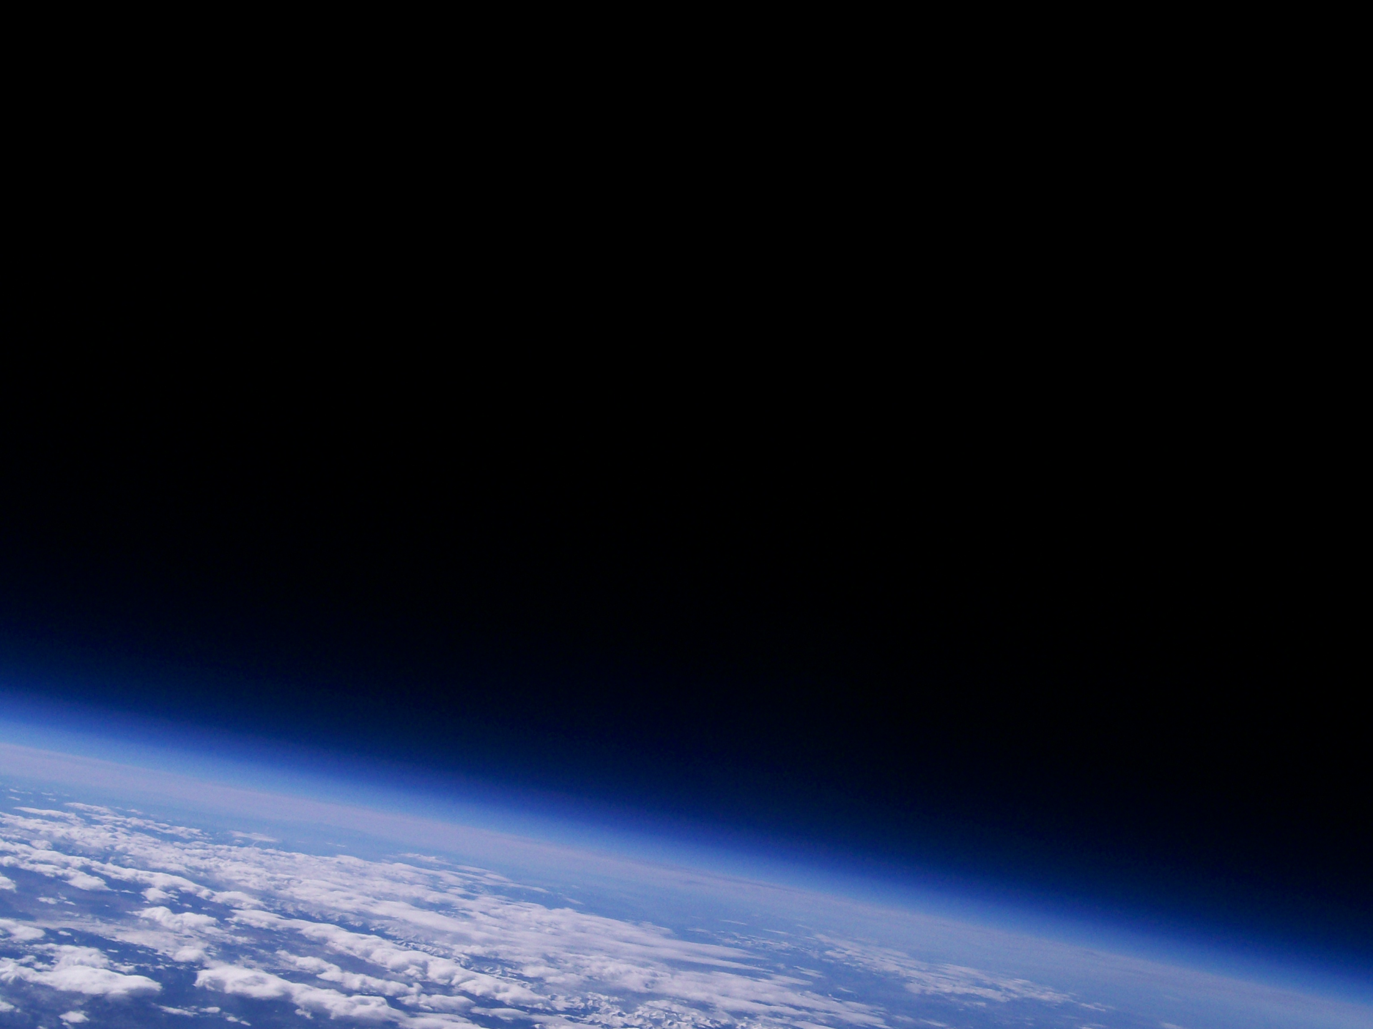
Launches
First Launch - Saturday, November 21st, 2009
Second Launch – Saturday, March 28th, 2010

Slide 3
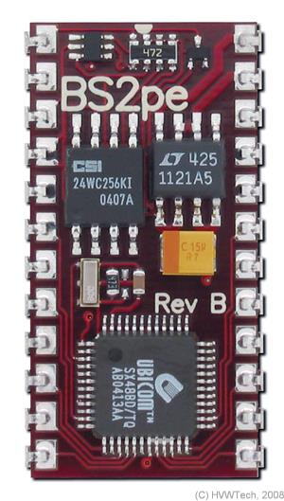
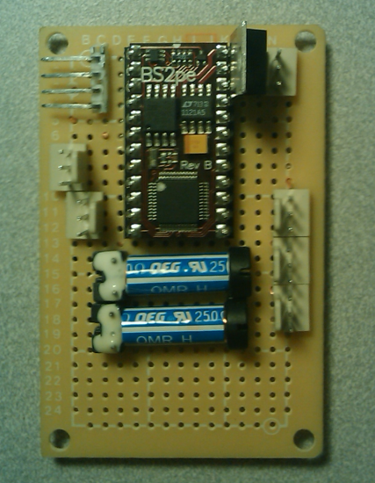
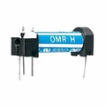
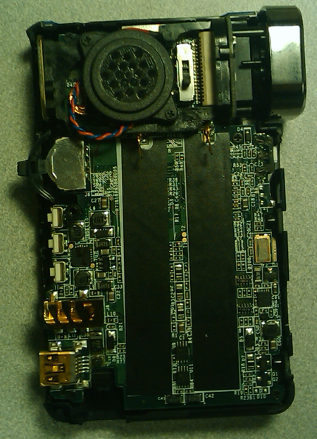
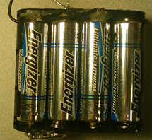
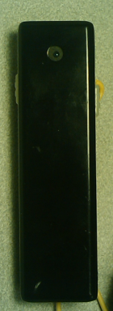
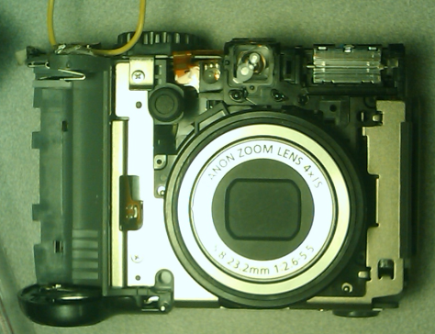
First Launch
Electronics
12 Energizer Lithium Ion Batteries
- Insignia digital Video Camera
-Micro video camera
- Canon picture camera, 8mp
- Basic stamp 2 microcontroller
Microcontroller
Battery pack wired in parallel for longer life
Micro video camera
Video Camera
Picture Camera

Slide 4
First Launch Results
The Insignia Digital Video Camera
- Was not able to recover any footage.
- The morning before the launch, it started to turn on and off.
Micro Video Camera
- Was able to get footage
- The video had a very low resolution and poor quality
Canon picture camera
- The light sensor was covered
- The pictures were overexposed and
- Barely visible and poor quality

Slide 5
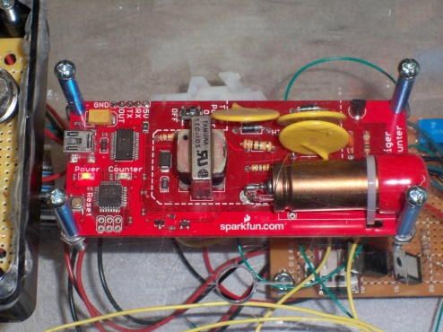
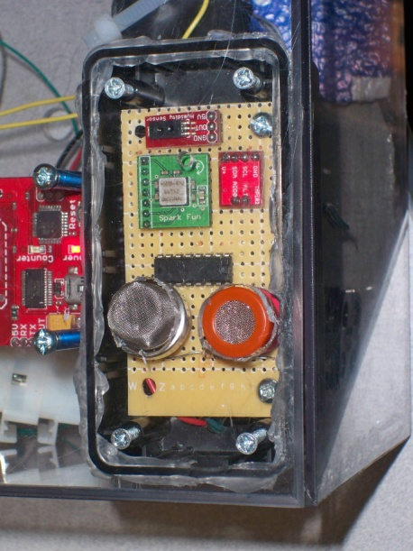
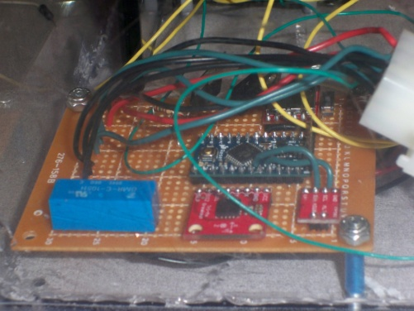
Second Launch
Electronics
- Energizer Lithium Ion Batteries
- Insignia Digital Video Camera
- Canon picture camera (8mp)
- Temperature sensors
- Pressure sensor
- Humidity sensor
- Accelerometer
- Geiger Counter
CO Sensor
Methane Sensor
Scientific Experiment
- Bacteria

Slide 6
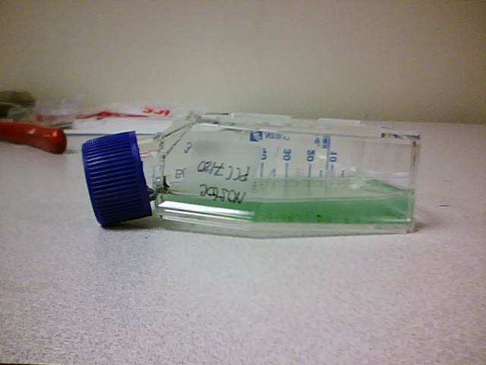
Bacteria Experiment Overview
Bacteria Experiment
Strain PCC 7120
Objective: Determine the ability of cyanobacteria to survive in space
Two Bacteria Cultures
Stain both bacterial cultures after payload returns to Earth
Cyanobacteria live in plant cells and are necessary for photosynthesis in plants.
Hypothesis: Bacteria flown into near space will either be killed, or will grow at a slower rate than the bacteria remaining in the lab
Picture Taken With Lauren’s Camera

Slide 7
Sensor Results

Slide 8
Sensor Results

Slide 9
Sensor Result

Slide 10
Bacteria Experiment Results
Bacteria Experiment
There are some bacteria colonies still alive
Further testing is being done in the lab
Hypothesis was wrong
Some bacteria colonies were able to overcome the effects and exposure to radiation
Picture Taken With Lauren’s Camera

Slide 11
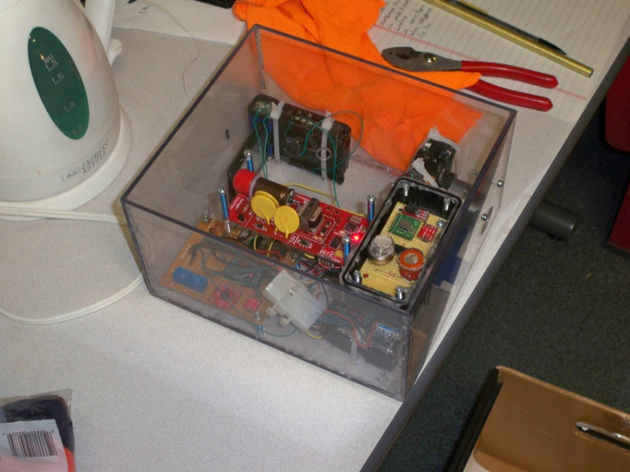
Improvement
Design of payload
Sensor Boards
Cameras
Scientific Experiment

Slide 12
Acknowledgments
ASU/NASA Space Grant
Arizona Space Grant Consortium
ANSR
Dr. Thomas Sharp
Jack Crabtree
Candace Jackson
Danielle Pies
ASU ASCEND Team

